Slide 1

50.039 Theory and Practice of Deep Learning W9-S2 The Embedding Problem
Matthieu De Mari, Berrak Sisman

Slide 2
About this week (Week 9)
Why are embeddings an essential component of Neural Networks (NNs)?
Why are good embeddings difficult to produce?
What are the conventional approaches to embeddings in NLP? What can we learn from these approaches?
What are the typical issues with embeddings and how do we address them?
State-of-the-art of current embedding problems, and open questions in research.

Slide 3
About this week (Week 9)
How do we evaluate the quality/performance of an embedding?
Can embeddings be biased?
Can we help the neural networks identify the important parts of the context to focus on?
What is attention in Neural Networks? What are transformers in Neural Networks?
What are the typical uses for attention these days?
What are the limits of attention and the current research directions on this topic?

Slide 4
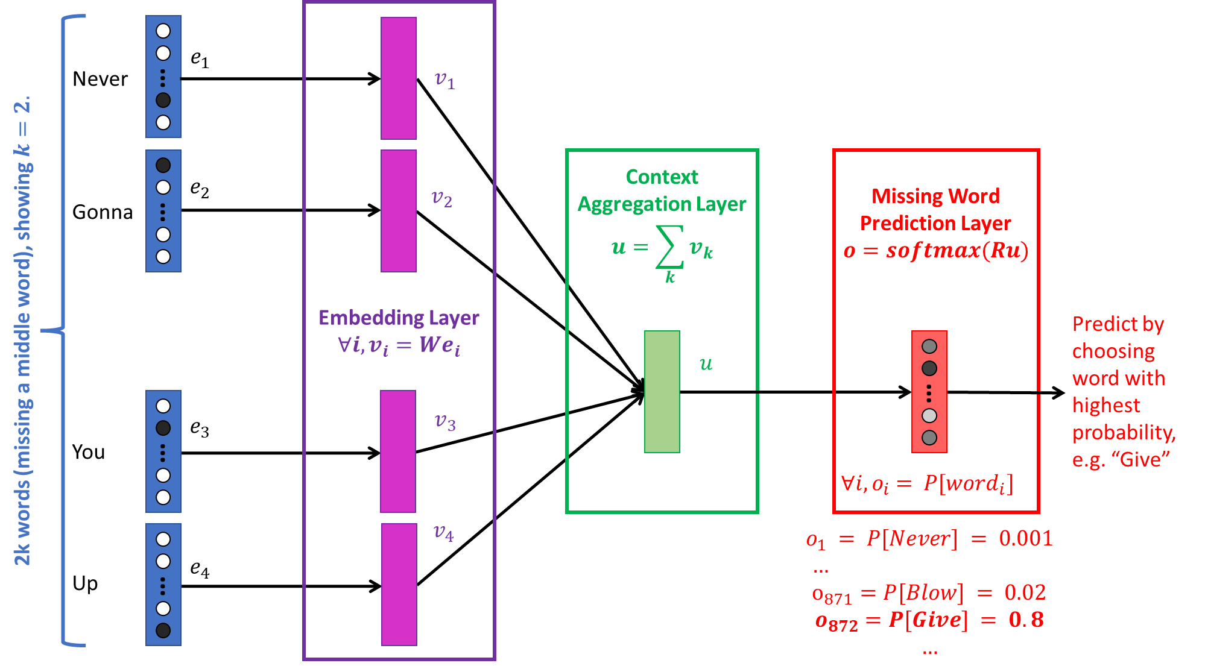
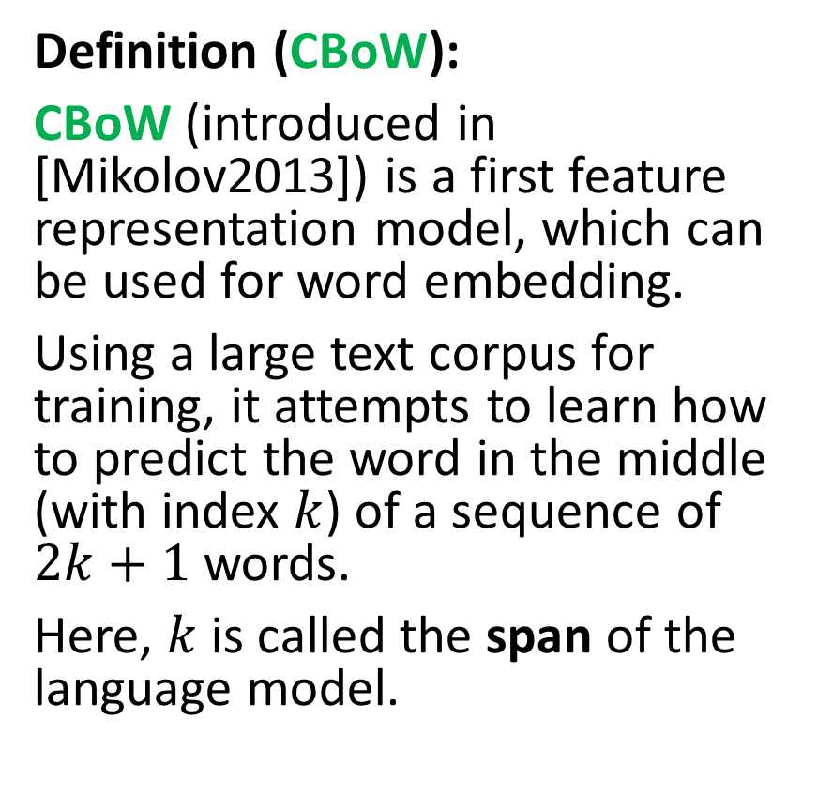
Continuous Bag of Words (CBoW)
Definition (CBoW):
CBoW (introduced in [Mikolov2013]) is a first feature representation model, which can be used for word embedding.
Using a large text corpus for training, it attempts to learn how to predict the word in the middle (with index $k$) of a sequence of $2k+1$words.
Here, $k$ is called the span of the language model.

Slide 5
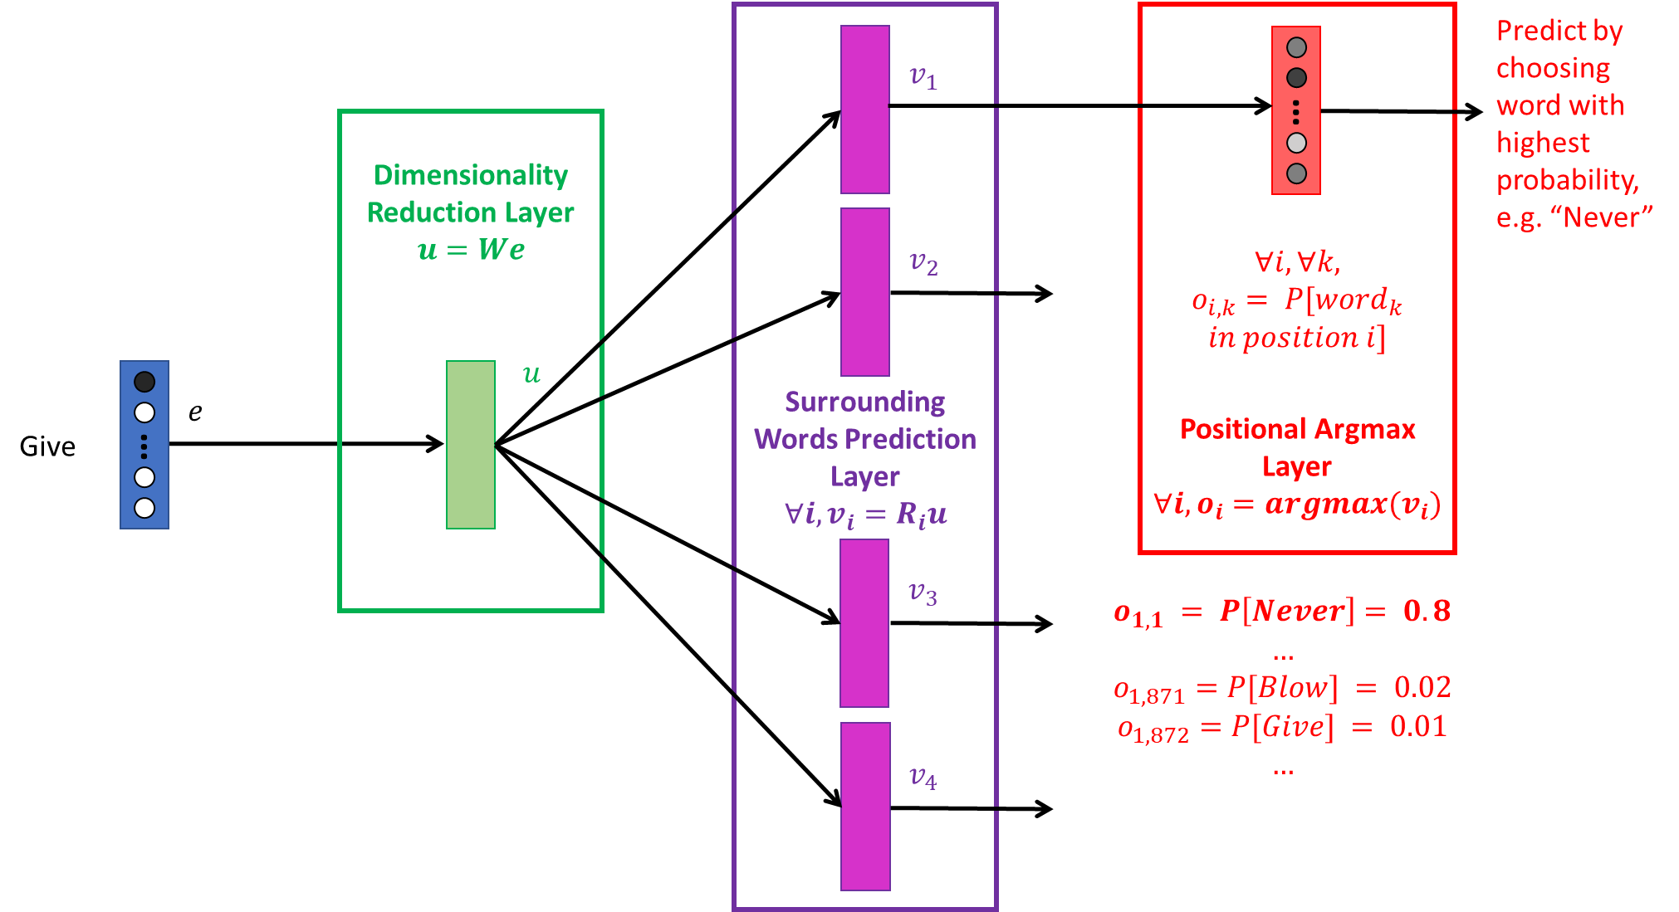
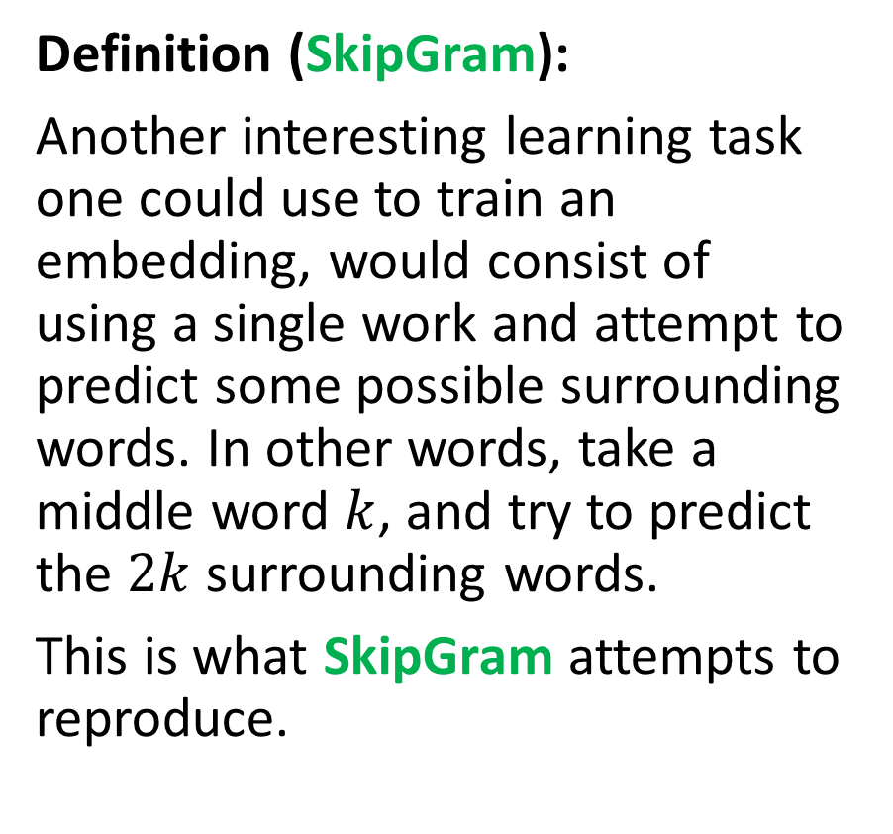
SkipGram (SG)
Definition (SkipGram):
Another interesting learning task one could use to train an embedding, would consist of using a single work and attempt to predict some possible surrounding words. In other words, take a middle word $k$, and try to predict the $2k$ surrounding words.
This is what SkipGram attempts to reproduce.

Slide 6


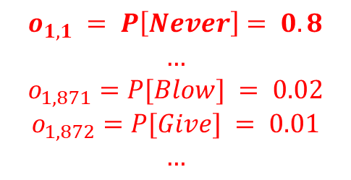


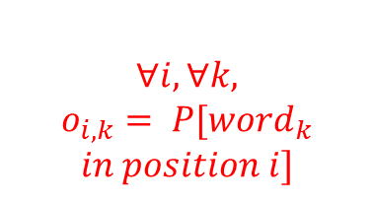





Surrounding Words Prediction Layer
$$∀i, v_{i}=R_{i}u$$
Positional Argmax Layer
$$∀i, o_{i}=argmax(v_{i})$$
Predict by choosing word with highest probability, e.g. “Never”
$$v_{1}$$
…
Dimensionality Reduction Layer
$$u=We$$
$$∀i, ∀k,$$
$$o_{i,k}= P[word_{k}$$
$$in position i]$$
$$v_{2}$$
$$u$$
$$e$$
Give
…
$$v_{3}$$
$$o_{1, 1} = P\left[Never\right]= 0.8$$
$$…$$
$$o_{1,871}=P[Blow] = 0.02$$
$$o_{1,872}=P[Give] = 0.01$$
$$…$$
$$v_{4}$$

Slide 7
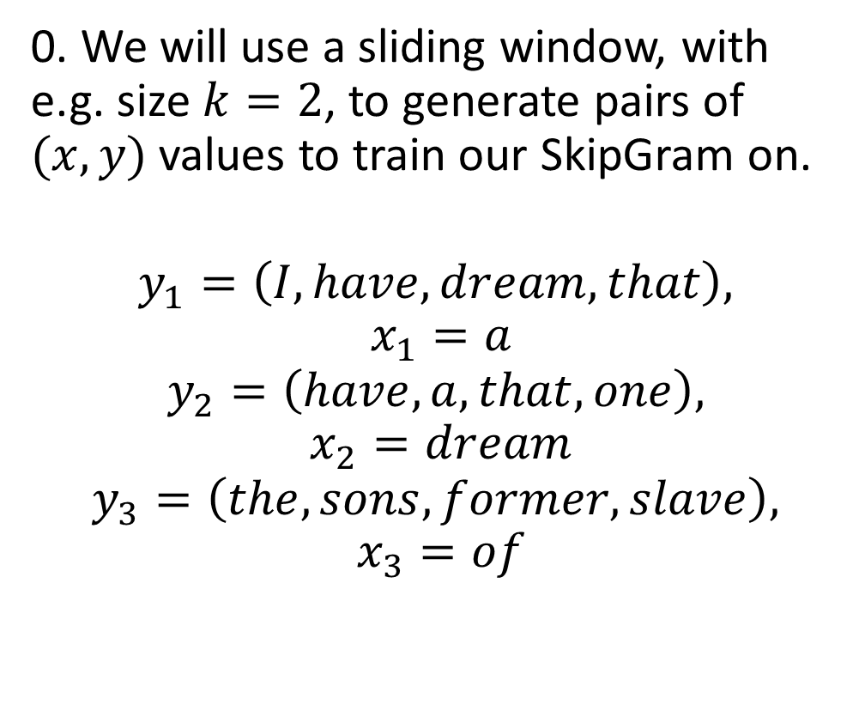
SkipGram (SG)
Consider the text: “I have a dream that one day this nation will rise up and live out the true meaning of its creed: We hold these truths to be self-evident, that all men are created equal. I have a dream that one day on the red hills of Georgia, the sons of former slaves and the sons of former slave owners will be able to sit down together at the table of brotherhood.”
0. We will use a sliding window, with e.g. size $k=2$, to generate pairs of $(x, y)$ values to train our SkipGram on.
$$y_{1}=\left(I, have,dream, that\right),$$
$$x_{1}=a$$
$$y_{2}=\left(have,a, that,one\right),$$
$$x_{2}=dream$$
$$y_{3}=\left(the, sons, former, slave\right),$$
$$x_{3}=of$$

Slide 8
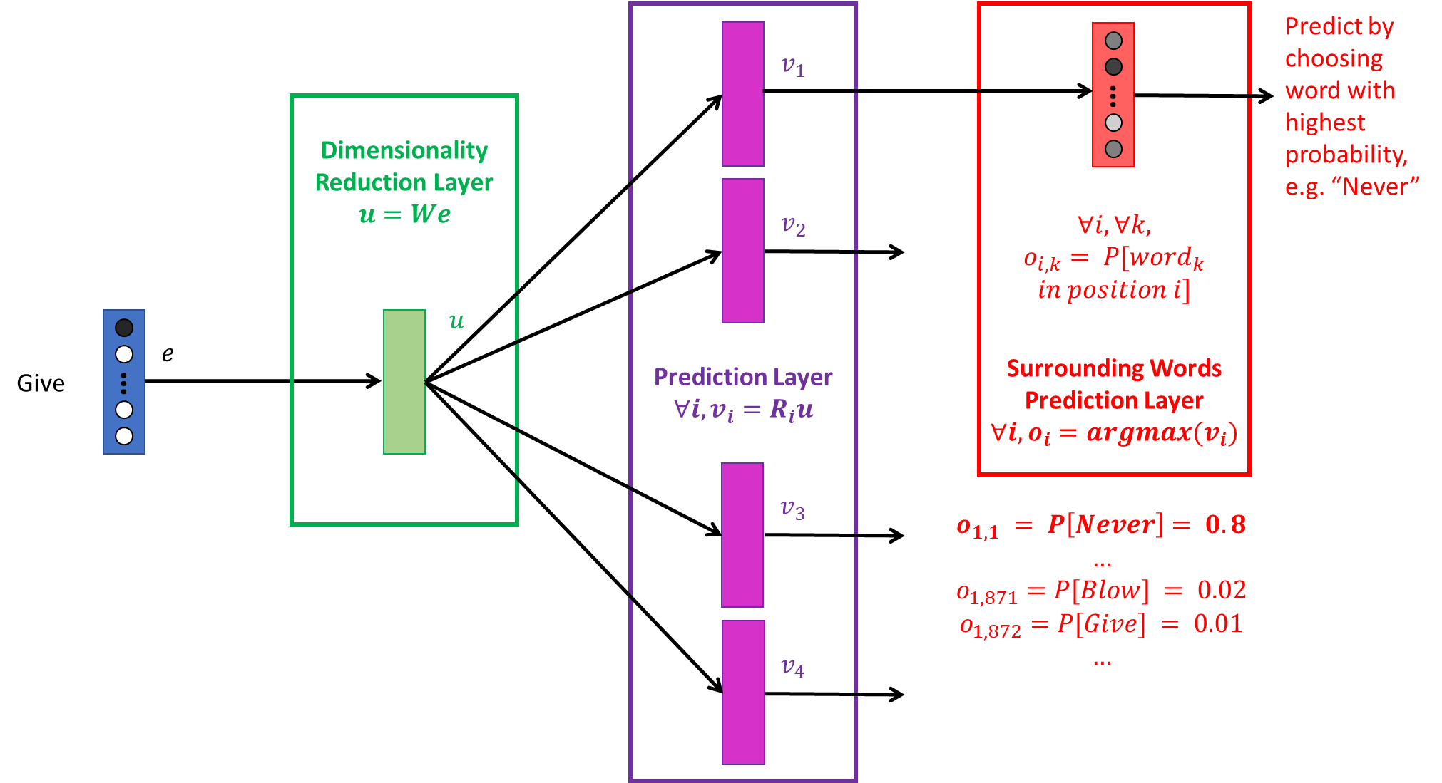
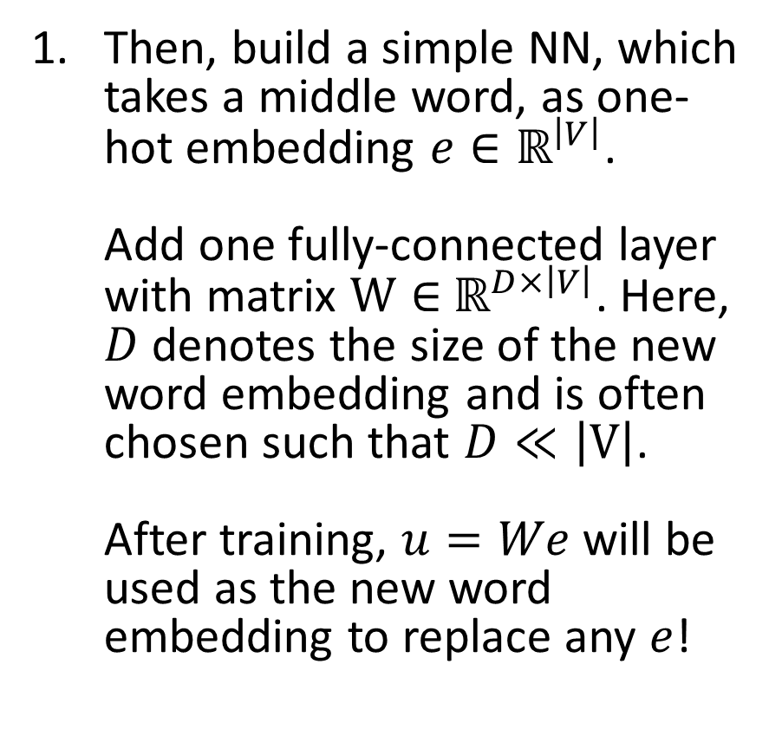
SkipGram (SG)
Then, build a simple NN, which takes a middle word, as one-hot embedding $e∈ℝ^{\left|V\right|}$. Add one fully-connected layer with matrix $W∈$ $ℝ^{D×\left|V\right|}$. Here, $D$ denotes the size of the new word embedding and is often chosen such that $D≪\left|V\right|$. After training, $u=We$will be used as the new word embedding to replace any $e$!

Slide 9
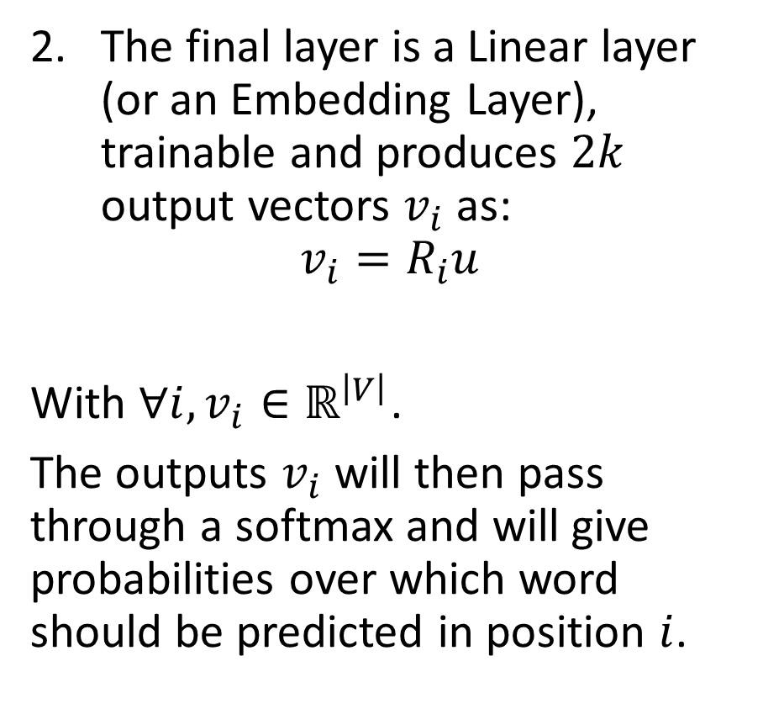
SkipGram (SG)
The final layer is a Linear layer (or an Embedding Layer), trainable and produces $2k$ output vectors $v_{i}$ as:
$$v_{i}=R_{i}u$$
With $∀i, v_{i}∈ℝ^{\left|V\right|}$.
The outputs $v_{i}$will then pass through a softmax and will give probabilities over which word should be predicted in position $i$.

Slide 10
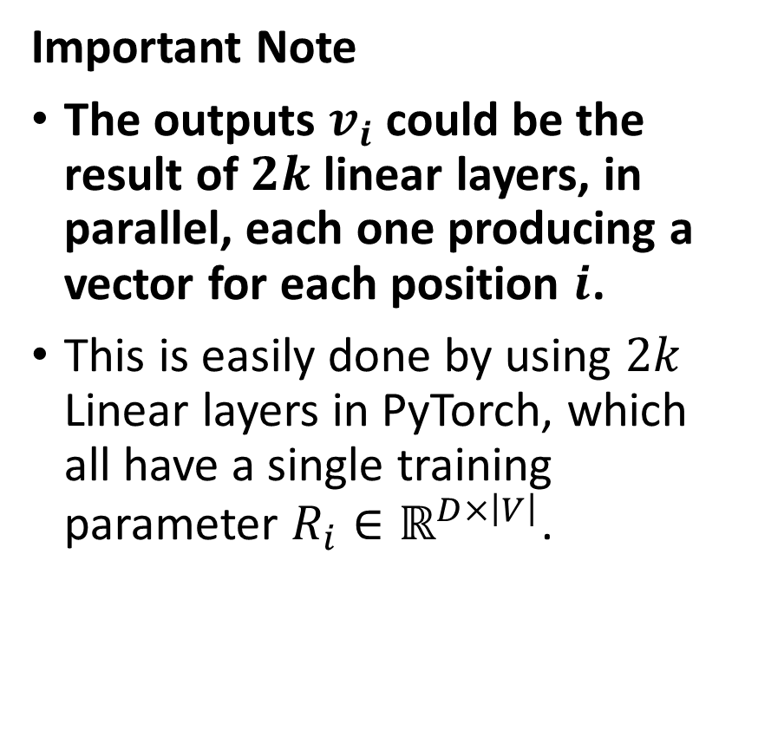
SkipGram (SG)
Important Note
The outputs $v_{i}$could be the result of $2k$ linear layers, in parallel, each one producing a vector for each position $i$.
This is easily done by using $2k$ Linear layers in PyTorch, which all have a single training parameter $R_{i}∈ℝ^{D×\left|V\right|}$.

Slide 11
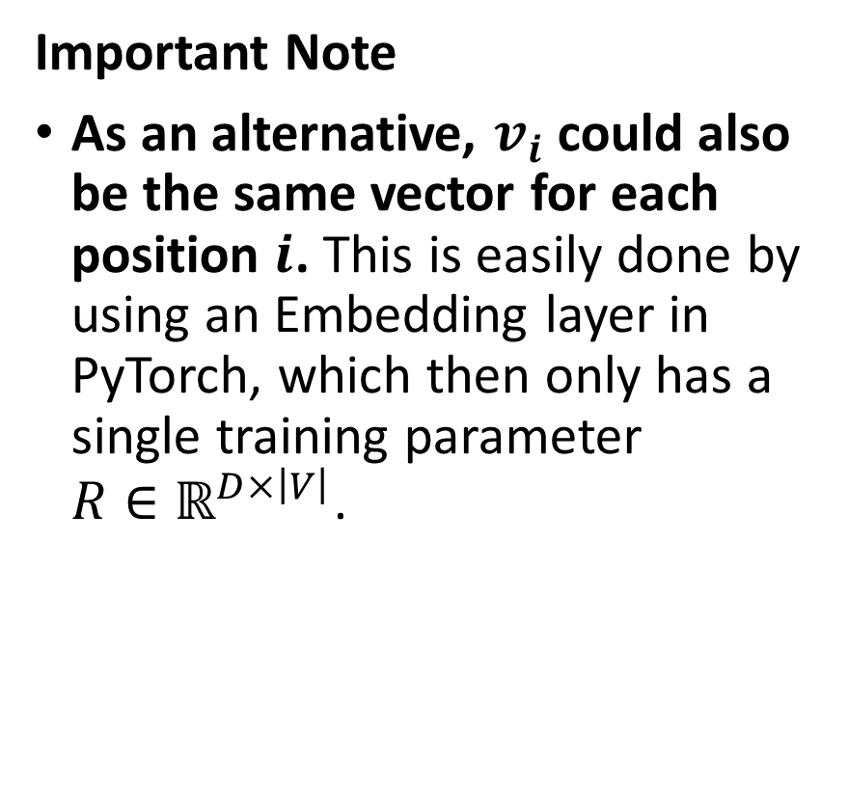
SkipGram (SG)
Important Note
As an alternative, $v_{i}$could also be the same vector for each position $i$. This is easily done by using an Embedding layer in PyTorch, which then only has a single training parameter $R∈ℝ^{D×\left|V\right|}$.

Slide 12
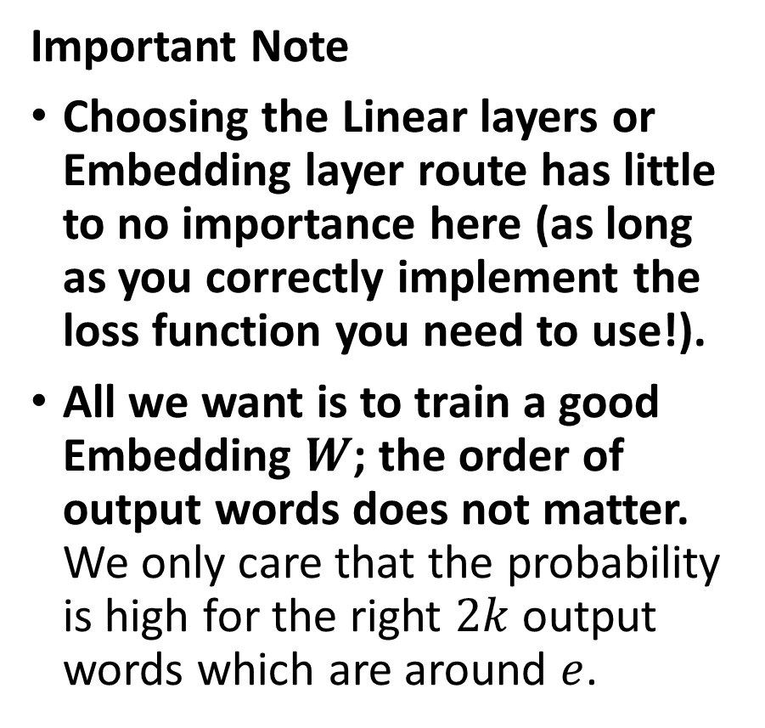
SkipGram (SG)
Important Note
Choosing the Linear layers or Embedding layer route has little to no importance here (as long as you correctly implement the loss function you need to use!).
All we want is to train a good Embedding $W$; the order of output words does not matter. We only care that the probability is high for the right $2k$ output words which are around $e$.

Slide 13
SkipGram (SG)
Important Note
This also means that training a SkipGram is far more difficult than training a CBoW!
It is however producing better encodings, as it produces embedding that are able to describe any word by (somewhat) predicting the surrounding words around it.

Slide 14
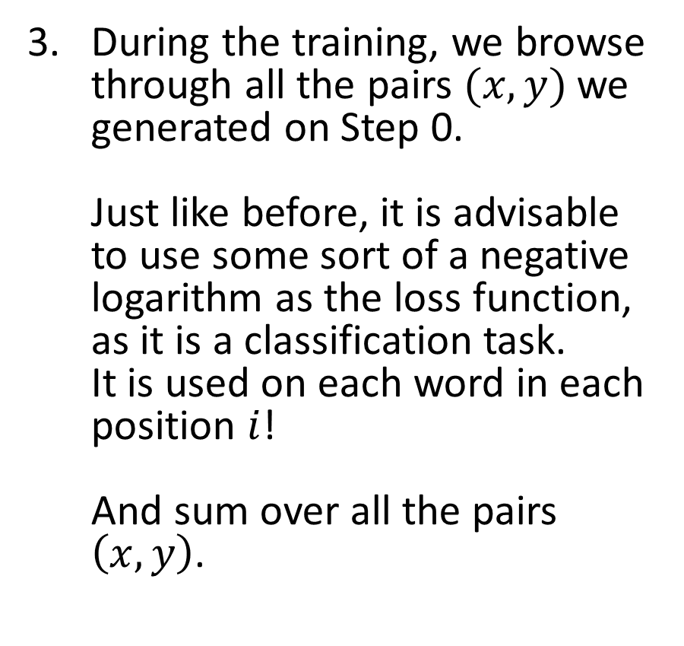
SkipGram (SG)
During the training, we browse through all the pairs $(x,y)$we generated on Step 0. Just like before, it is advisable to use some sort of a negative logarithm as the loss function, as it is a classification task. It is used on each word in each position $i$! And sum over all the pairs $\left(x,y\right)$.

Slide 15
Homework this week will require to train a SkipGram (correctly!)
HW9!

Slide 16
Word2Vec and Glove
The two approaches (CBoW and SkipGram) are commonly referred to as Word2Vec approaches.
Another option, often referred to in literature is GloVe (Global Vectors for Word Representation).
Another “simple” count-based embedding [GloVe2014] and was considered a good challenger to Word2Vec.
Choose a Pre-Trained Embedding If
Your dataset is composed of more “general” language and you don’t have that big of a dataset, to begin with.
Since these embeddings have been trained on a lot of words from different sources, pre-trained models might do well if your data is generalized as well.
Also, you will save on time and computing resources with pre-trained embeddings.

Slide 17
Word2Vec and Glove
Choose to Train Your Own Embedding If
Your data (and project) is based on a niche industry, such as medicine, finance or any other non-generic and highly specific domains.
In such cases, a general word embedding representation might not work out for you and some words might be altogether missing from the pre-trained embeddings.

Slide 18
Word2Vec and Glove
Choose to Train Your Own Embedding If
Your data (and project) is based on a niche industry, such as medicine, finance or any other non-generic and highly specific domains.
In such cases, a general word embedding representation might not work out for you and some words might be altogether missing from the pre-trained embeddings.
On the downside, a lot of data is needed to ensure that the word embeddings being learned do a proper job of representing the various words and the semantic relationships between them, unique to your domain.
Also, it takes a lot of computing resources to go through your corpus and build word embeddings.

Slide 19
Word2Vec and Glove
Both Word2Vec and GloVe approaches are commonly referred to as unsupervised (or semi-supervised) approaches to embedding, both relying on the distributional hypothesis we mentioned on the previous lecture.
Unsupervised representation learning of sentences had been the norm for quite some time.
More advanced versions of unsupervised approaches exist!
For instance: FastText and ELMo.

Slide 20
FastText
FastText was developed by the team of Mikolov (him again!), triggering the explosion of research on universal word embeddings [Mikolov2018].

Slide 21
Universal embeddings?
A huge trend in DL/NLP is the quest for Universal Embeddings.
Definition (Universal Embedding):
Universal Embeddings are embeddings that are pre-trained on a large corpus and can be plugged in a variety of downstream task models to automatically improve their performance, by incorporating some general word/sentence representations learned on larger datasets.
In a sense, it is the ultimate form of transfer learning for language embeddings, the holy grail, i.e. a unique universal embedding that everyone can use on any task related to language.
Open question: Are universal embeddings even possible or good? Should not they be task-specific?

Slide 22
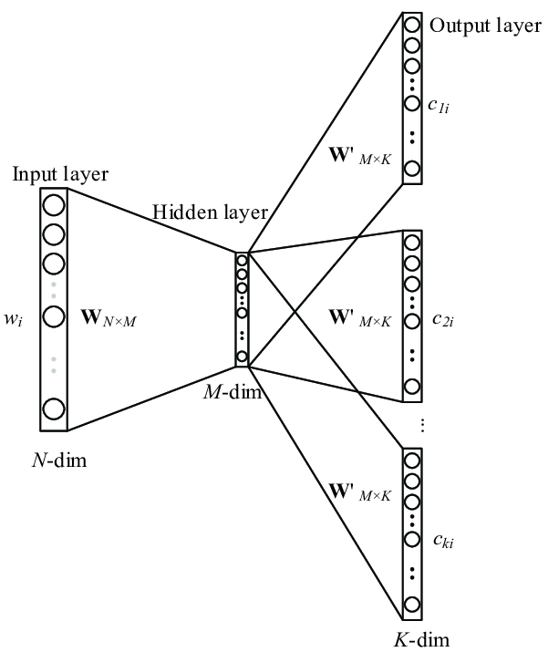
FastText
Input: Concatenation of word + its n-grams.
(e.g. “eating” + “ea” + “eat” + “ati” + “tin” + “ing”)
FastText was developed by the team of Mikolov (him again!), triggering the explosion of research on universal word embeddings [Mikolov2018].
The main improvement of FastText over the original word2vec vectors is the inclusion of character n-grams, which allows computing word representations for words that did not appear in the training data (something called “out-of-vocabulary” words).
Model: Skip-Gram Architecture
(Predict context words based on single word + its n-grams)
Output: 2k words of context.

Slide 23
“Out of vocabulary” words
Definition (out-of-vocabulary):
Embeddings are often subject to the out-of-vocabulary issue.
This is a simple concept: what should the embedding function be doing if it is asked to encode a word that is not contained in the original dictionary V?
(Think new words, typos, etc.)
Word $w∉V$
Word 𝑤∉𝑉
Embedding function $f(w)$
Embedding function 𝑓(𝑤)
???

Slide 24
“Out of vocabulary” words
Definition (out-of-vocabulary):
Embeddings are often subject to the out-of-vocabulary issue.
This is a simple concept: what should the embedding function be doing if it is asked to encode a word that is not contained in the original dictionary V?
(Think new words, typos, etc.)
In the case of Word2Vec (CBoW and SkipGram algorithms), this would be very invalidating, as we would have no way to one-hot encode the missing word.
Word $w∉V$
Word 𝑤∉𝑉
Embedding function $f(w)$
Embedding function 𝑓(𝑤)
???

Slide 25
“Out of vocabulary” words
Definition (out-of-vocabulary):
Embeddings are often subject to the out-of-vocabulary issue.
This is a simple concept: what should the embedding function be doing if it is asked to encode a word that is not contained in the original dictionary V?
(Think new words, typos, etc.)
In the case of Word2Vec (CBoW and SkipGram algorithms), this would be very invalidating, as we would have no way to one-hot encode the missing word.
A good embedding function should then be able to, at least partially, operate on out-of-vocabulary words.
Word $w∉V$
Word 𝑤∉𝑉
Embedding function $f(w)$
Embedding function 𝑓(𝑤)
???

Slide 26
Core idea behind FastText (out-of-class)
Input: Concatenation of word + its n-grams.
(e.g. “eating” + “ea” + “eat” + “ati” + “tin” + “ing”)
FastText achieves really good performance for word representations, specially in the case of rare words by making use of character level information.
Each word is represented as a bag of characters n-grams in addition to the word itself.
For example, for the word “computer”, with n = 3, the FastText representations for the character n-grams is <co, com, omp, mpu, put, ute, ter, er>.
Model: Skip-Gram Architecture
(Predict context words based on single word + its n-grams)
Output: 2k words of context.

Slide 27
Core idea behind FastText (out-of-class)
Input: Concatenation of word + its n-grams.
(e.g. “eating” + “ea” + “eat” + “ati” + “tin” + “ing”)
Then, FastText uses the same approach and logic as in SkipGram, to try and predict some context words, by using not just the word, but also its n-grams.
This typically allows to identify etymology in words, and cover for potential typos!
Overall reinforces the performance, allows to address the out of vocabulary issue!
Model: Skip-Gram Architecture
(Predict context words based on single word + its n-grams)
Output: 2k words of context.

Slide 28
FastText
FastText was developed by the team of Mikolov (him again!), triggering the explosion of research on universal word embeddings [Mikolov2018].
The main improvement of FastText over the original word2vec vectors is the inclusion of character n-grams, which allows computing word representations for words that did not appear in the training data (something called “out-of-vocabulary” words).
FastText vectors are super-fast to train and are available in 157 languages trained on Wikipedia and Crawl. They are a great baseline, not sacrificing too much performance.
Ready-to-use FastText embeddings from: https://github.com/facebookresearch/fastText
Official (and good) tutorial: https://fasttext.cc/docs/en/unsupervised-tutorial.html

Slide 29

ELMo
The Deep Contextualized Word Representations (a.k.a. Embeddings for Language Model - ELMo) have recently improved the state of the art in word embeddings by a noticeable amount.
They were developed by the Allen institute for AI and were presented at NAACL 2018 in early June [Peters2018].
Ready-to-use ELMo embeddings https://allennlp.org/elmo
Official and good tutorial: https://guide.allennlp.org/

Slide 30
ELMo
Key takeaways
Input of words, into a character-level network (inputs will be a list of characters!)
To get an embedding of a word, input the whole sentence for context, then take only the vector which corresponds to that word.
On top of character-level network, use multiple layers of RNNs on word-level.
Train the whole network for the task of predicting the next word in sentence, almost as in CBoW.
After training, extract embedding layer for feature representation

Slide 31
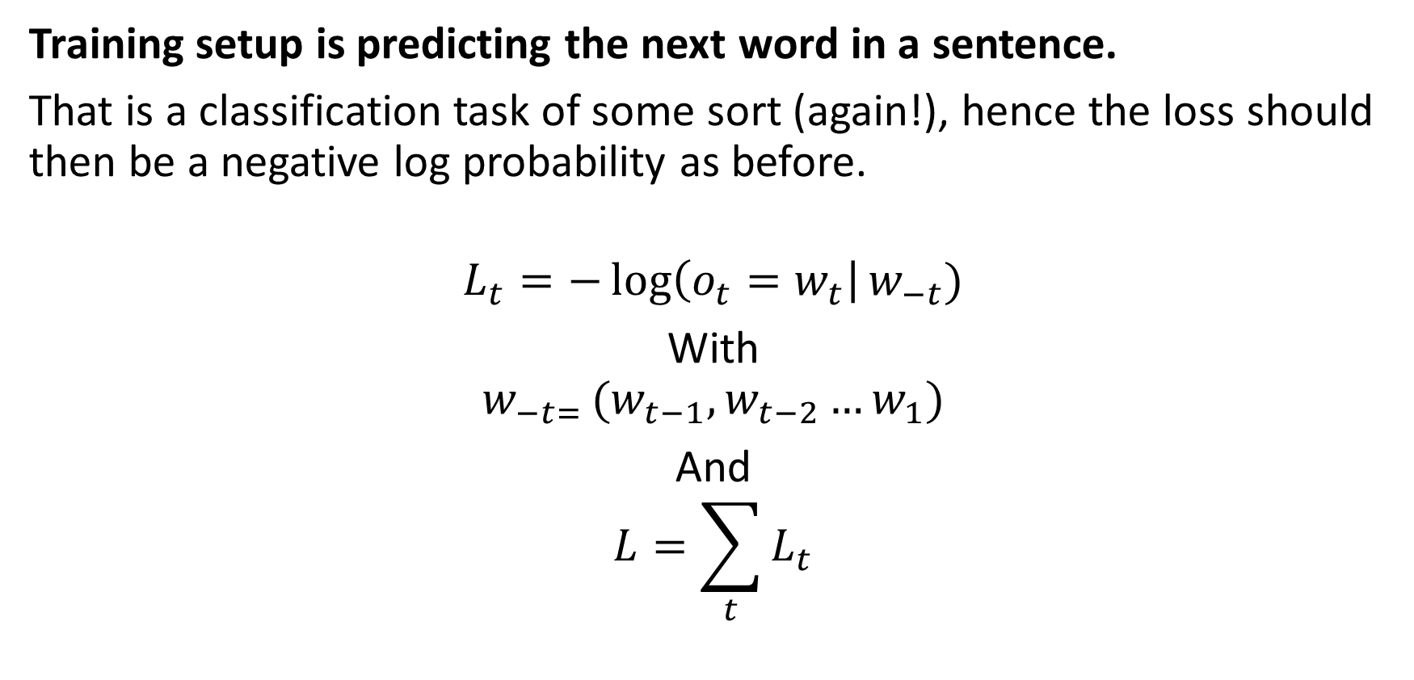
Core idea behind ELMo (out-of-class)
Training setup is predicting the next word in a sentence.
That is a classification task of some sort (again!), hence the loss should then be a negative log probability as before.
$$L_{t}=−\log\left(o_{t}=w_{t}\right|w_{−t})$$
With
$${w_{−t= }(w}_{t−1},w_{t−2}…w_{1})$$
And
$$L=\sum_{t}{L_{t}}$$

Slide 32
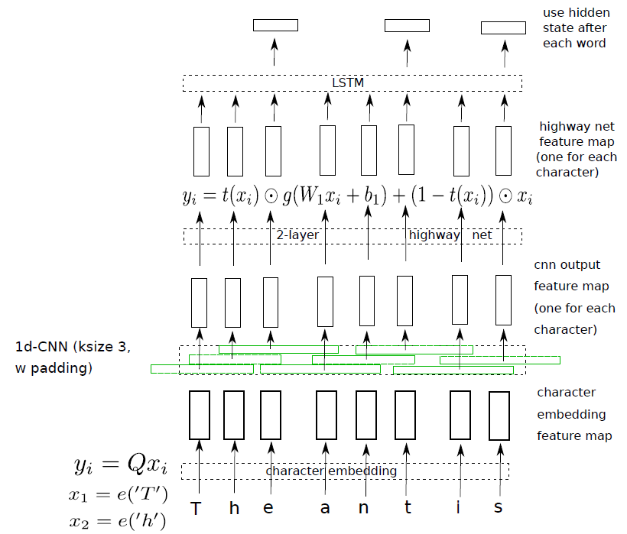
Core idea behind ELMo (out-of-class)
Bottom layer 1: input each word by as a sequence of characters into a character-level network. Then feed its output feature vectors character by character as input into a word-level RNN at the top.
No problems with out of vocabulary words, because input of a word is done as a sequence of characters!
Also, low dimensionality!

Slide 33
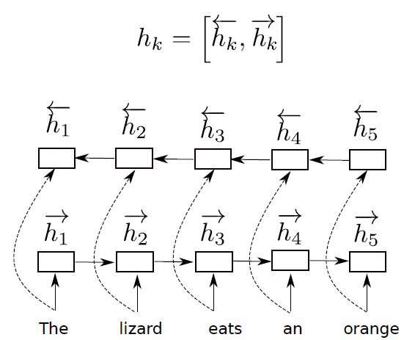
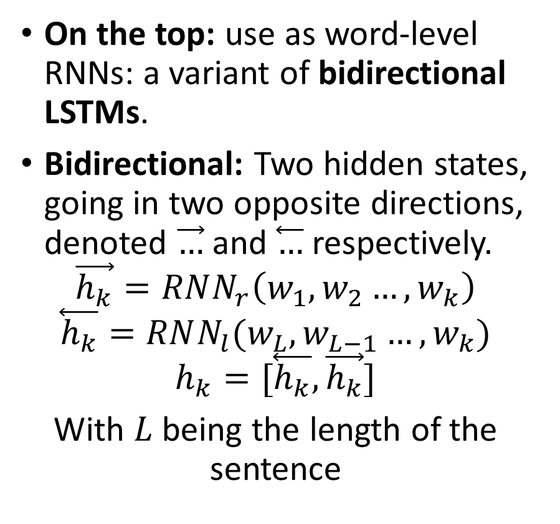
Core idea behind ELMo (out-of-class)
On the top: use as word-level RNNs: a variant of bidirectional LSTMs.
Bidirectional: Two hidden states, going in two opposite directions, denoted $\vec{…}$ and $\overset{⃖}{…}$ respectively.
$$\vec{h_{k}}=RNN_{r}\left(w_{1},w_{2}…,w_{k}\right)$$
$$\overset{⃖}{h_{k}}=RNN_{l}(w_{L},w_{L−1}…,w_{k})$$
$$h_{k}=[\overset{⃖}{h_{k}},\vec{h_{k}}]$$
With $L$ being the length of the sentence

Slide 34
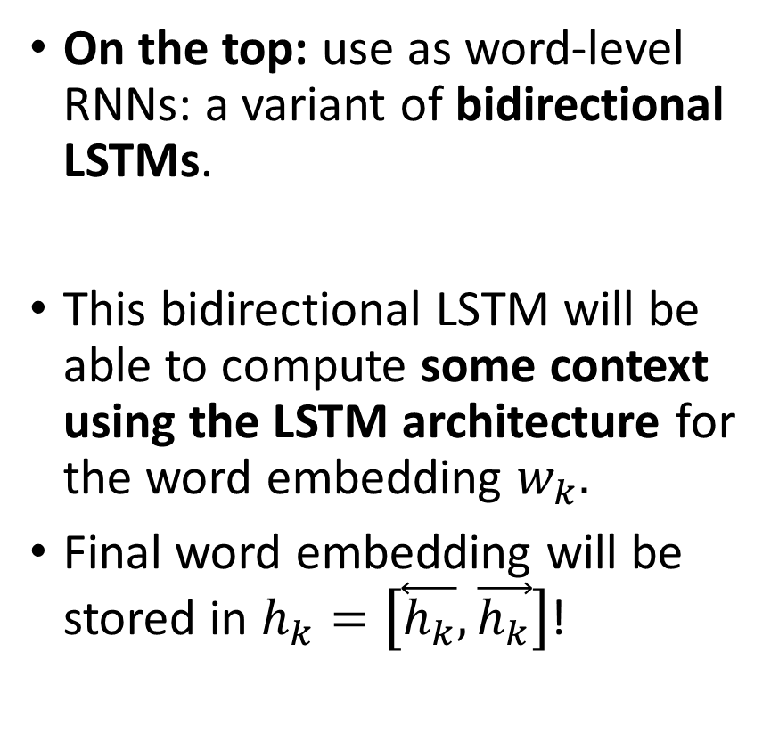
Core idea behind ELMo (out-of-class)
On the top: use as word-level RNNs: a variant of bidirectional LSTMs.
This bidirectional LSTM will be able to compute some context using the LSTM architecture for the word embedding $w_{k}.$
Final word embedding will be stored in $h_{k}=\left[\overset{⃖}{h_{k}},\vec{h_{k}}\right]$!

Slide 35
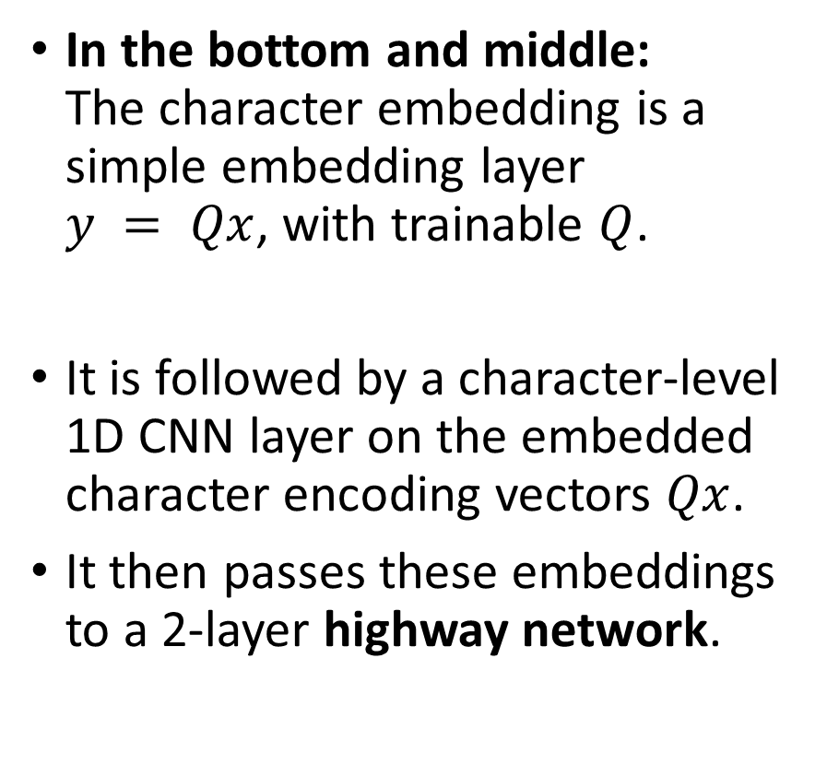
Core idea behind ELMo (out-of-class)
In the bottom and middle: The character embedding is a simple embedding layer $y = Qx$, with trainable $Q$.
It is followed by a character-level 1D CNN layer on the embedded character encoding vectors $Qx$.
It then passes these embeddings to a 2-layer highway network.

Slide 36
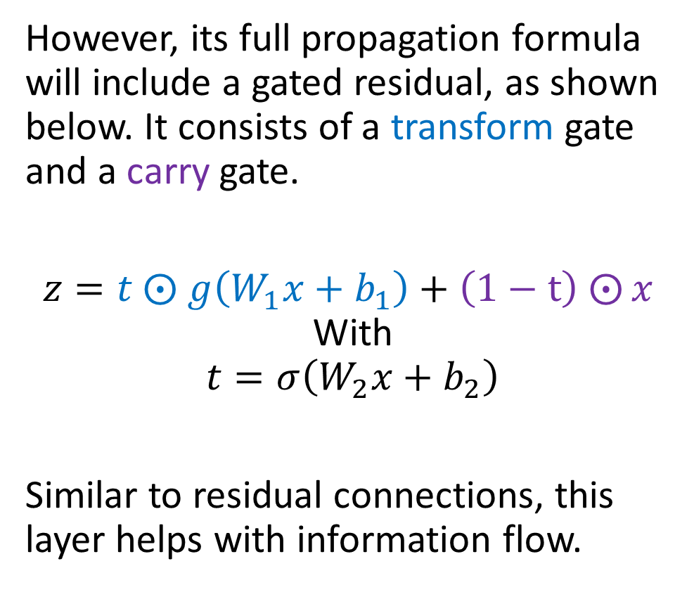
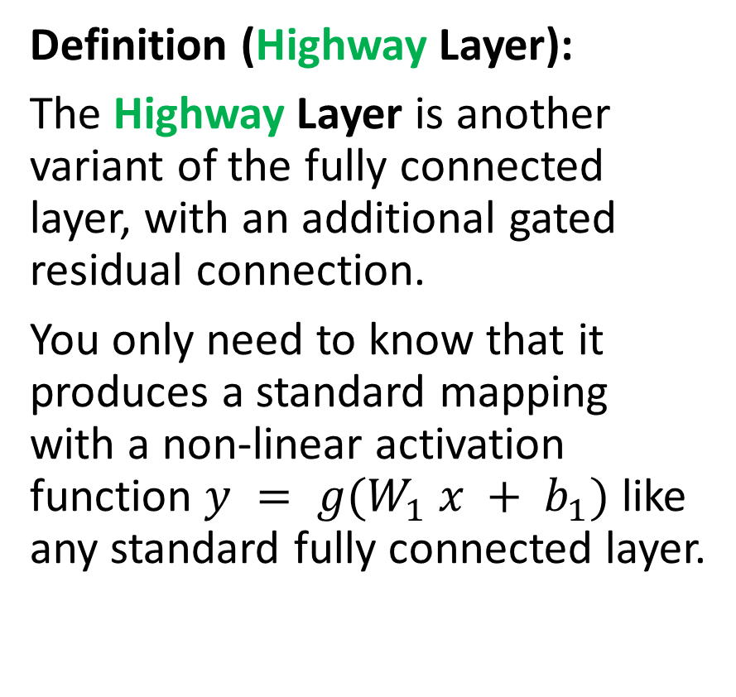
A quick note on the Highway Layer
Definition (Highway Layer):
The Highway Layer is another variant of the fully connected layer, with an additional gated residual connection.
You only need to know that it produces a standard mapping with a non-linear activation function $y = g(W_{1} x + b_{1})$ like any standard fully connected layer.
However, its full propagation formula will include a gated residual, as shown below. It consists of a transform gate and a carry gate.
$z=t ⨀$ $g\left(W_{1}x+b_{1}\right)+\left(1−t\right)$ $⨀{x }$ With
$$t=σ\left(W_{2}x+b_{2}\right)$$
Similar to residual connections, this layer helps with information flow.

Slide 37
ELMo
Key takeaways on ELMo
ELMo is a pretty recent word embedding (2018!), which has, for a long time, held the state-of-the-art performance for word embeddings.
These days (2021-2022), the state of the art is the BERT embedding. (to be discussed on the next lecture, after the lesson on transformers!)
It is able to operate on out-of-vocabulary words, as it takes characters as inputs, and can process context to address Problem #1 (as opposed to CBoW/SG & FastText)
Its main downside is the computational cost of the architecture. Preferable to use FastText if you need speed!

Slide 38
Supervised and combined learning?
Word2Vec, GloVe and ELMo approaches are commonly referred to as unsupervised (or semi-supervised) approaches to embedding, both relying on the distributional hypothesis we mentioned on the previous lecture.
Unsupervised representation learning of sentences had been the norm for quite some time.
More advanced versions of unsupervised approaches exist!
However, the last few years have seen a shift toward supervised and multi-task learning schemes with a number of notably interesting proposals in late 2017/early 2018.

Slide 39
From unsupervised to combined learning
For a long time, there was a general consensus (see [Wang2018] for details) in the field that
the simple approach of simply averaging a sentence’s word vectors (as in CBoW approach) gives a strong baseline for context, which is good enough for many downstream tasks.
supervised learning of sentence/word embeddings was costly and gave lower-quality embeddings than unsupervised/semi-supervised approaches.
But these assumptions have recently been overturned, in part following the publication of the InferSent ([Conneau2018]) results.

Slide 40
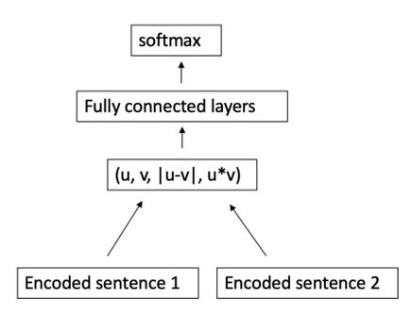
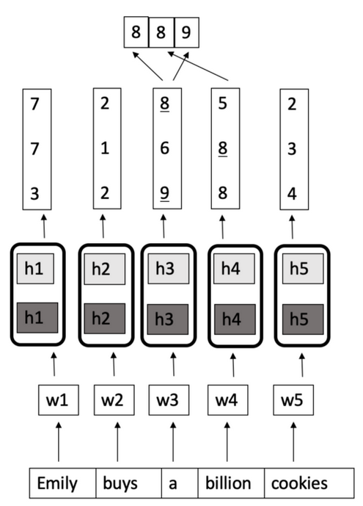
Counter-example: InferSent (out-of-class)
Simple key takeaways
The InferSent model (in [Conneau2018]) is an example of a supervised classification model, with three classes: Entailment, Neutral, Contradiction.
It uses the same forward-backward LSTM architecture as ELMo, and attempts to compare two sentences and classify the pair.
Feature representation extracted from model showed good performance.

Slide 41
From unsupervised to combined learning
Following these recent results, showing that supervised approaches are not necessarily bad…
The current direction in research for word embeddings suggests to combine both supervised and unsupervised learning techniques. This is commonly referred to as a multi-task learning based embedding.
The most notable work in this direction would be Google’s Universal Sentence and Word Encoder (in [Cer2019]). Kept rather hidden, have only seen a pre-release on Tensorflow: https://www.tensorflow.org/hub/tutorials/semantic_similarity_with_tf_hub_universal_encoder
(But nothing for PyTorch yet?)

Slide 42
Conclusion (W9S2)
We have seen a few approaches to embeddings.
Train an AI to figure out embeddings? Basic approaches.
(CBoW)
SkipGram
Out of dictionary entries?
Use FastText!
Need to incorporate context words for embedding?
Use ELMo!
Advanced methods
Supervised: InferSent
(Multi-task: Google’s Universal Embedding?)
A few more problems are still open at the moment for these word embeddings.
Can these embedding be biased? Yes, unfortunately.
Can we help the network in computing context? BERT, later.

Slide 43
Learn more about these topics
Out of class, for those of you who are curious
[Mikolov2013] Mikolov et al., “Efficient Estimation of Word Representations in Vector Space”, 2013. https://arxiv.org/abs/1301.3781
[Mikilov2014] Mikolov et al., “Distributed Representations of Words and Phrases and their Compositionality”, 2014. https://arxiv.org/abs/1310.4546
[GloVe2014] Pennington et al., “GloVe: Global Vectors for Word Representation”, 2014. https://nlp.stanford.edu/projects/glove/

Slide 44
Learn more about these topics
Out of class, for those of you who are curious
[Mikolov2018] Mikolov et al., “Advances in Pre-Training Distributed Word Representations”, 2018. https://arxiv.org/abs/1301.3781
[Peters2018] Peters et al., “Deep contextualized word representations”, 2018. https://arxiv.org/abs/1802.05365
[Wang2018] Wang et al., “GLUE: A Multi-Task Benchmark and Analysis Platform for Natural Language Understanding” https://arxiv.org/abs/1804.07461

Slide 45
Learn more about these topics
Out of class, for those of you who are curious
[Conneau2018] Conneau et al., “Supervised Learning of Universal Sentence Representations from Natural Language Inference Data”, 2018. https://arxiv.org/abs/1705.02364
[Cer2019] Cer et al., “Universal Sentence Encoder”, 2019. https://arxiv.org/abs/1803.11175

Slide 46
Learn more about these topics
Tracking important names (Track their works and follow them on Scholar, Twitter, or whatever works for you!)
Alexis Conneau: Senior Researcher at Google. https://scholar.google.fr/citations?user=45KfCpgAAAAJ&hl=fr
Matthew E. Peters: Senior researcher at Allen Institute. https://scholar.google.com/citations?user=K5nCPZwAAAAJ&hl=en
Daniel Cer: Researcher at Google and Lecturer at UC Berkeley. Has a really good course about NLP and Embeddings. https://scholar.google.com/citations?user=BrT1NW8AAAAJ&hl=en https://www.ischool.berkeley.edu/user/4406 https://www.ischool.berkeley.edu/courses/datasci/266

